Slide 1
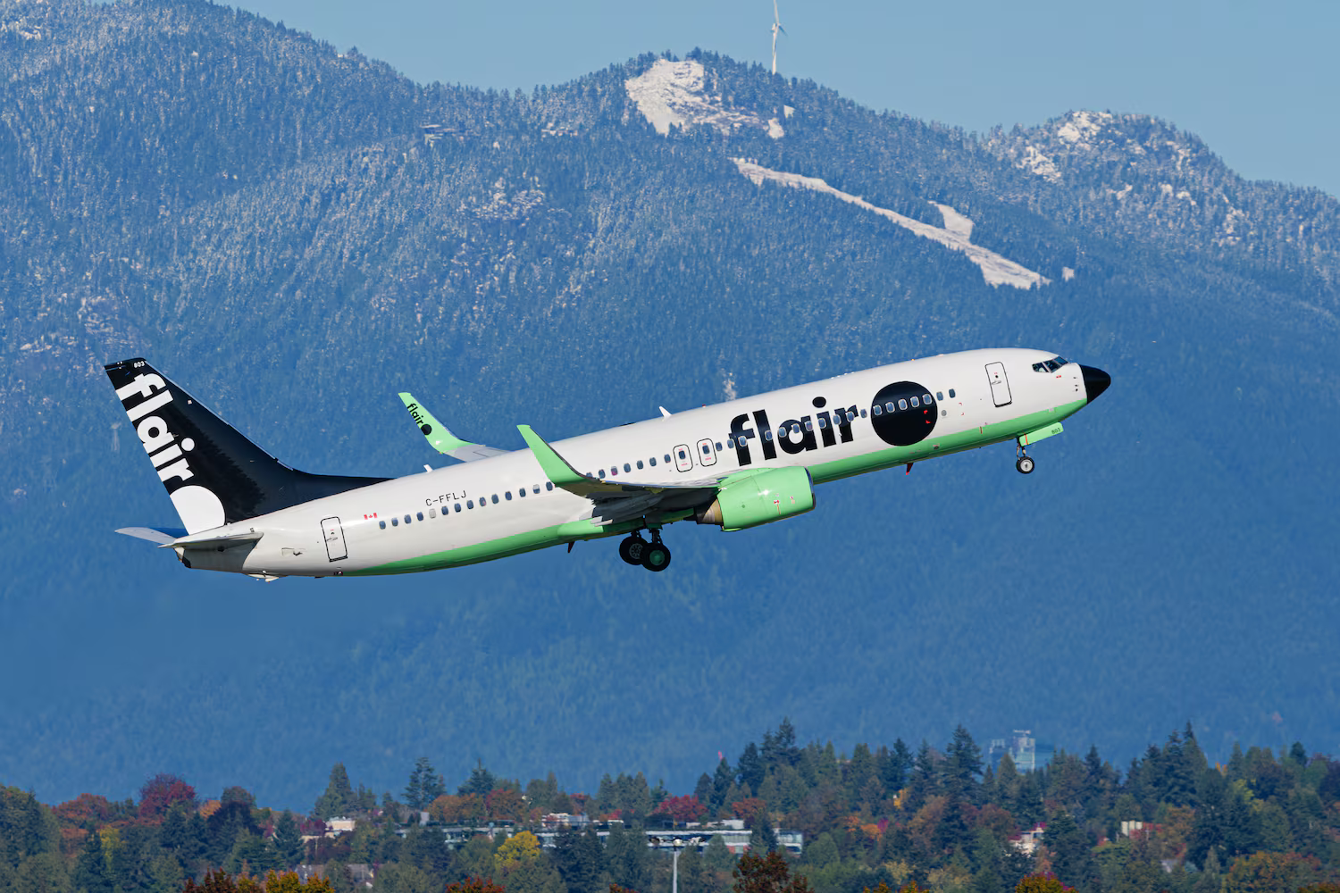

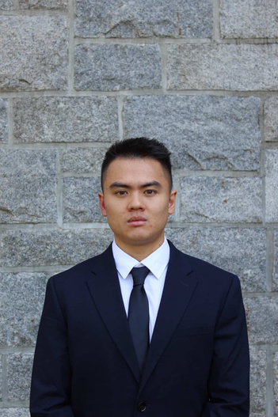
Taking
National Strategy Case Competition 2025
Member 1
Member 2
Rick

Slide 2
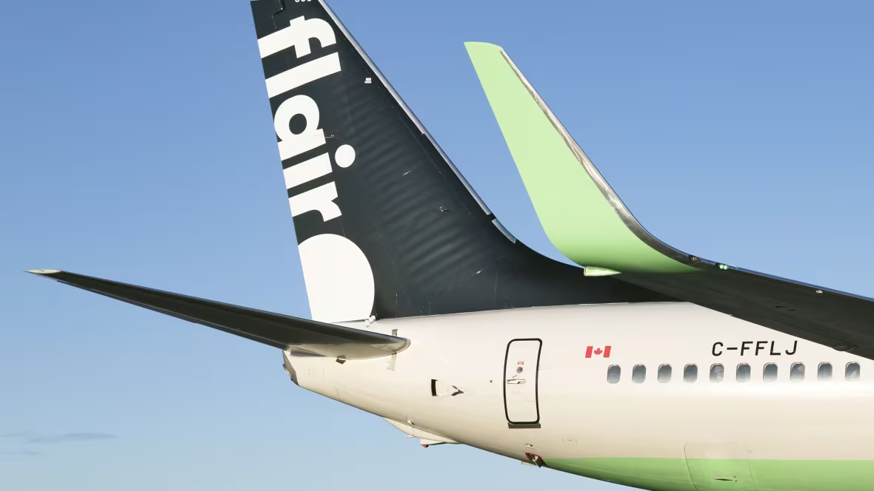
Situational Analysis
2

Slide 3

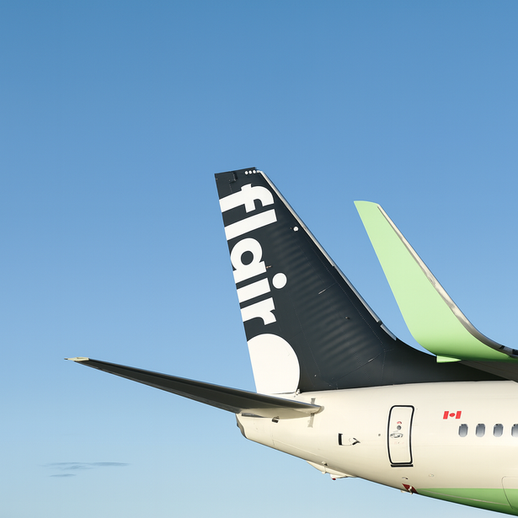
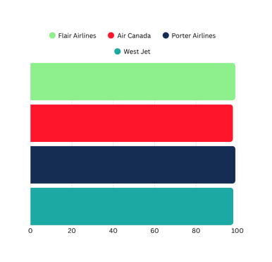
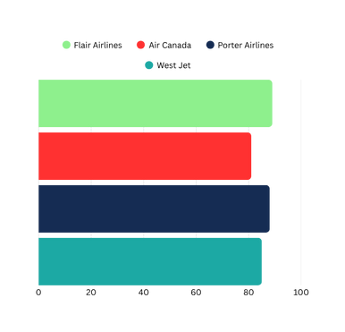




Situational Analysis
Company Overview
Founded in 2005 (Kelowna, BC) as a charter carrier; transitioned to ULCC in 2017
Canada’s only independent Ultra Low-Cost Carrier (ULCC) remaining after the 2024 exits of Lynx Air and Canada Jetlines.
Competes nationally with Air Canada and WestJet, and directly with Porter Airlines in the value-oriented segment.
Rebranded in 2019 with its distinct green-and-black livery.
After being an interim CEO for a year, Maciej Wilk has been named CEO in July 2025
Mission: To make air travel affordable, reliable, and accessible for all Canadians.
Vision: To become Canada’s most trusted low-cost airline.
Market leadership
in airline performance (Sep 2025)
99.64%
Completion Rate
89.2%
On-Time Performance
3.5M
Passangers
(2024)
3.84%
Market Share
(2024)
1M
99.64%
89.2%
25%
Revenue
(2024)
97.81%
81.96%
~25%
Revenue
(2024)
99.06%
88.30%
98.66%
85.31%
Analysis
Recommendation
Implementation

Slide 4
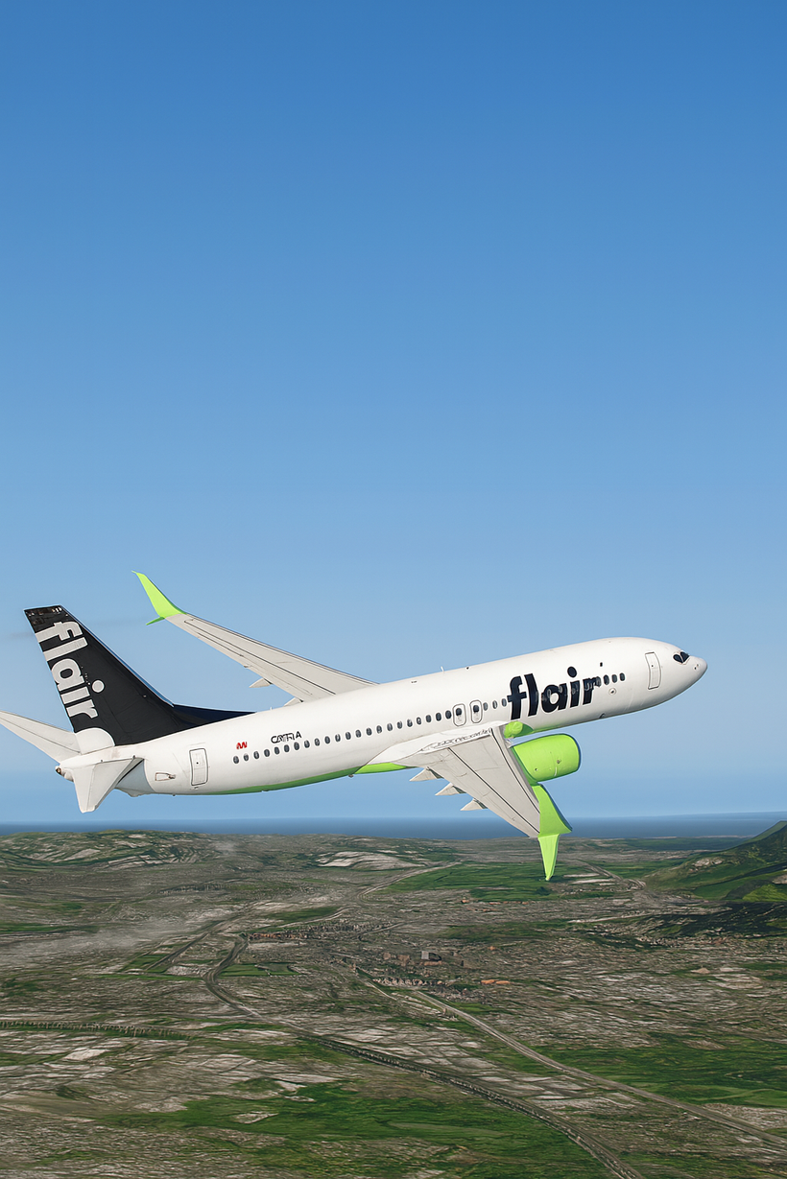
Situational Analysis
Positioning
Moving forward:
Continue to be a low cost reliable carrier.
Aims to deliver a message of change
Reliable, efficient, bold and dynamic
Analysis
Recommendation
Implementation

Slide 5

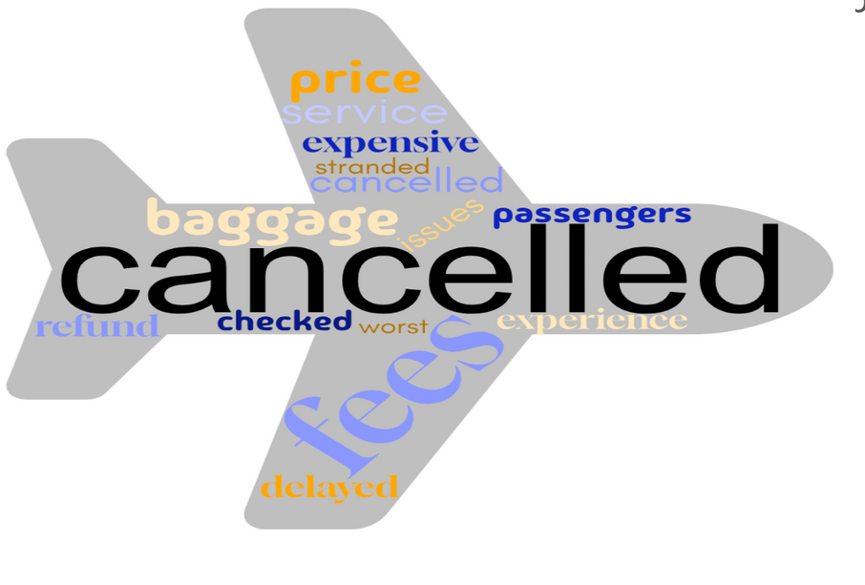
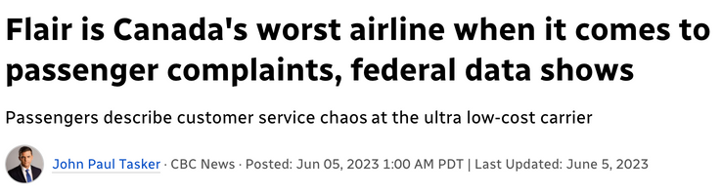





Problem 1
Reputational Challenges
Public discussion still frames Flair as “affordable BUT unreliable”
Even as on-time performance now leads the industry (89.2%), negative reviews still persist because awareness of this progress remains low.
External Evidence
Customer Sentiment:
Media Reports:
User-Generated Reviews:
— CBC News (May 2023)
— Runaway Traveller (September 2025)
Analysis
Recommendation
Implementation

Slide 6

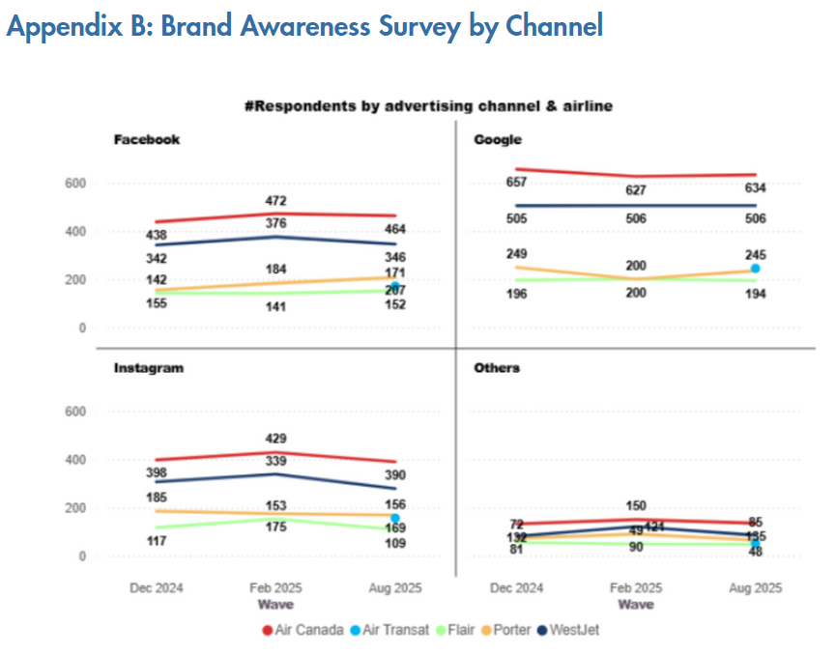
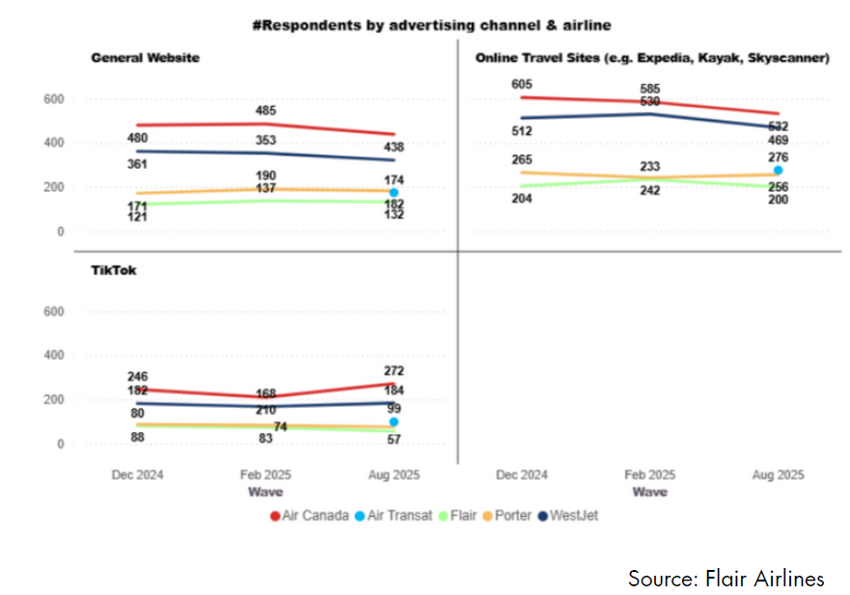

Problem 2
Messaging Weakness
“Canadians are becoming increasingly familiar with the Flair Airlines name, but awareness of new efforts has been low and continuously decreasing”
Analysis
Recommendation
Implementation

Slide 7
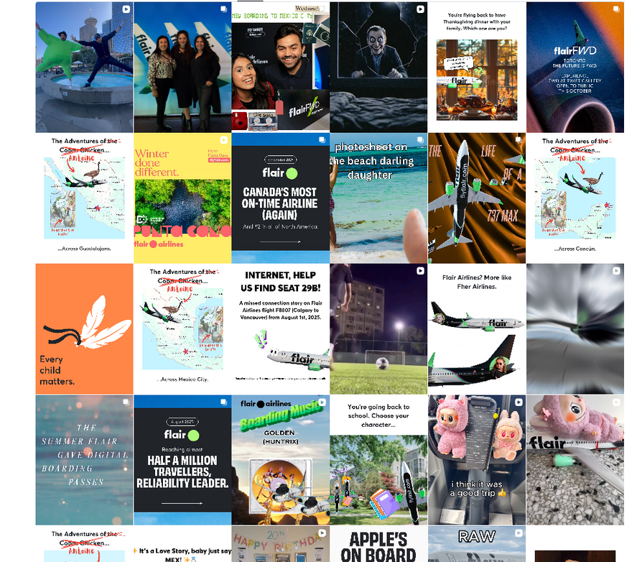
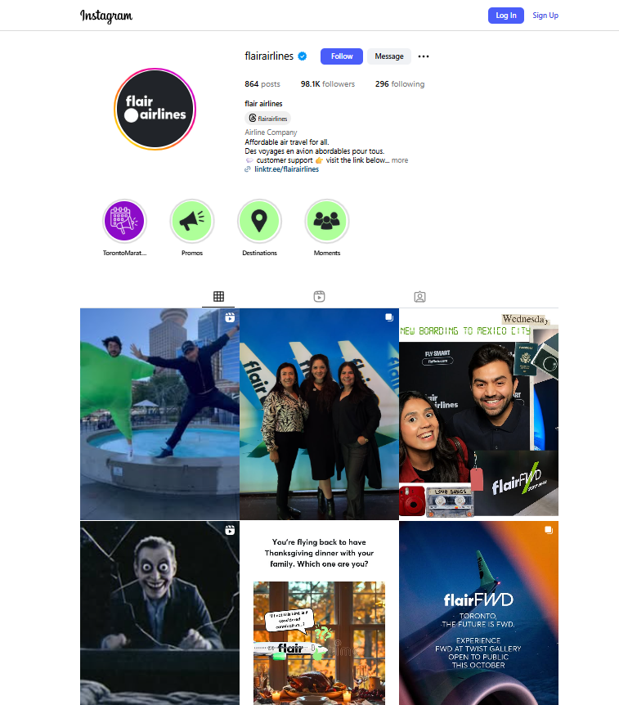

Problem 2
Messaging Weakness
Content irrelvance
No common theme colour
Analysis
Recommendation
Implementation

Slide 8
Problem 2
Messaging Weakness
Lack of brand awareness
Messaging weakness
Lack of uniform branding
Low relevance of content
8
Analysis
Recommendation
Implementation

Slide 9

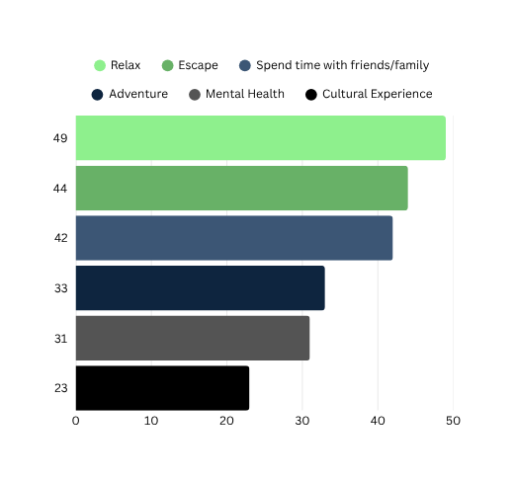
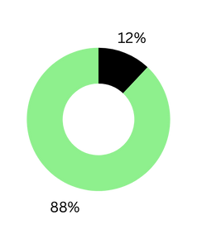
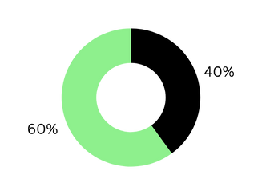
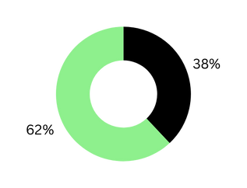

Problem 3
Disconnect with Target Segment
Despite being an ULCC, there is low brand awareness within our own target markets, particularly Gen Z travelers and residents of the GTA.
Cause: Limited alignment and personalization with the target segment’s travel preferences and behaviors.
Gen-Z Travel Trend
Reasons to Travel
Impact of Social Media
Use tech to save on travel
Use TikTok as primary source
Follow a traveler influencer
Missing Actions from Flair
No campaign curated to Gen-Z.
Lacking social media reliability and connection.
Analysis
Recommendation
Implementation

Slide 10
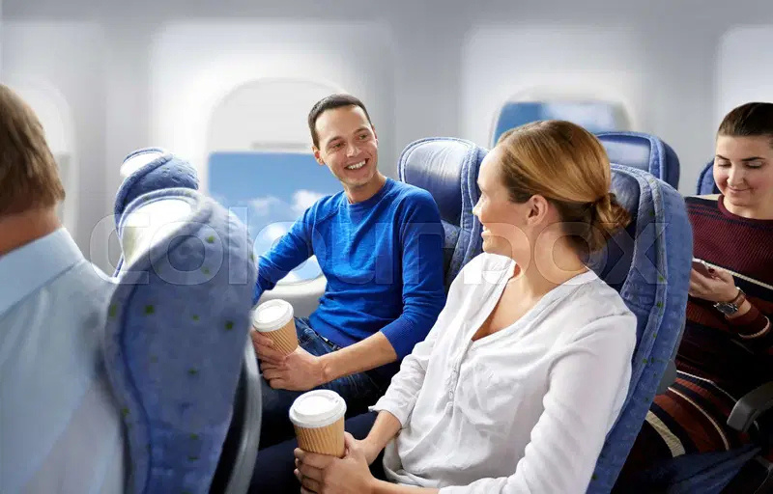
Strategic Recommendation

Slide 11

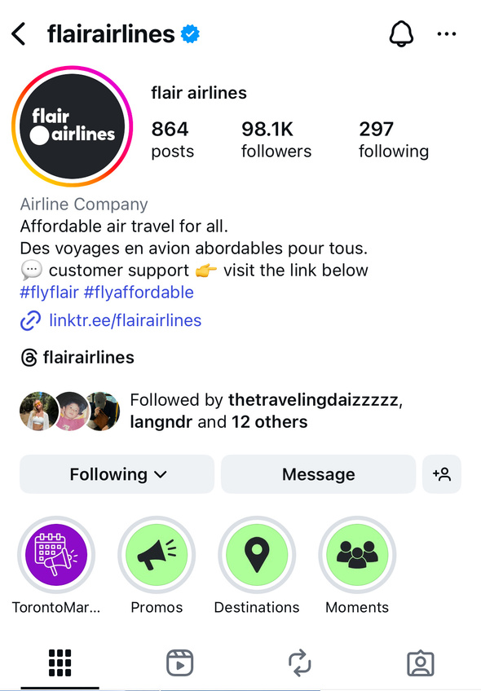


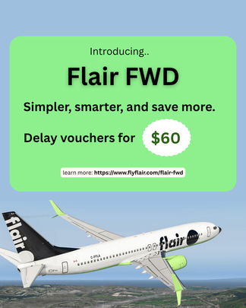


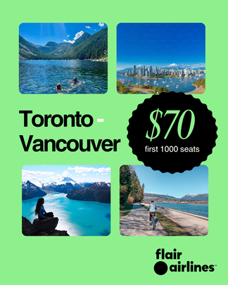


Recommendation 1:
Social Media Enhancement
1
FWD Paid Advertisement
Content improvement
4
2
Uniform branding
5
Key Opinion Leader (KOL)
FWD
Destinations
Promo
3
FWD Information Display
Analysis
Recommendation
Implementation

Slide 12



Recommendation 1:
Social Media Rebranding
1
FWD Paid Advertisement
Analysis
Recommendation
Implementation

Slide 13
Recommendation 1:
Social Media Branding
Uniform branding
2
Uniform branding
2
FWD
Destinations
Promo
Posts in themed colour
Analysis
Recommendation
Implementation

Slide 14
Recommendation 1:
Social Media Branding
Dedicated reel
Uniform branding
2
Uniform branding
2
FWD Information Display
FWD
Destinations
Promo
3
FWD Information Display
3
Pinned FWD posts
Posts in themed colour
Analysis
Recommendation
Implementation

Slide 15
Recommendation 1:
Social Media Branding
Dedicated reel
Uniform branding
2
Uniform branding
2
Other related content
FWD Information Display
FWD
Destinations
Promo
3
FWD Information Display
3
Content Improvement
a. The fwd and other programs
b. The latest marketing campaigns
c. Info on new destinations
d. Other related contents
Pinned FWD posts
4
Posts in themed colour
The latest marketing campaign
Info on new destination
Analysis
Recommendation
Implementation

Slide 16

Recommendation 1:
Social Media Branding
5
Key Opinion Leader (KOL)
Marketing
Analysis
Recommendation
Implementation

Slide 17

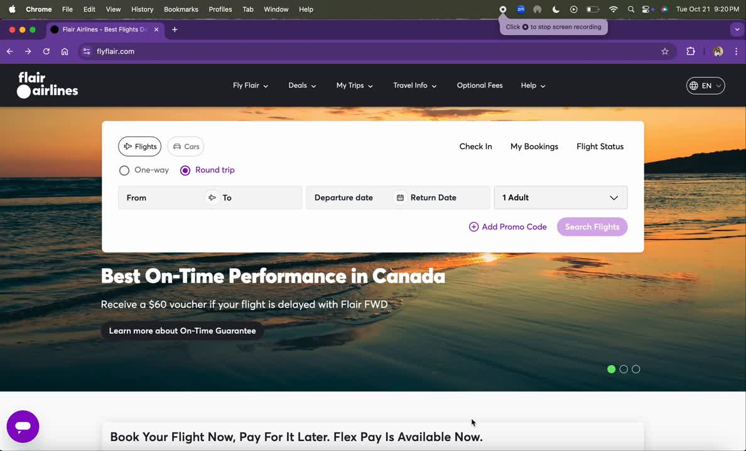
Recommendation 2:
Website Modification
1
More visible FWD Information
The current website makes no mention of Flair FWD, leaving passengers unaware of the airline’s biggest improvements.
We redesigned the landing page to highlight Flair FWD, the On-Time Guarantee, and reliability metrics above the fold — all visible without scrolling.
17
Analysis
Recommendation
Implementation

Slide 18
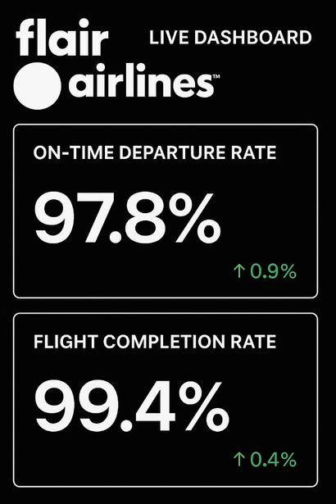
Recommendation 2:
Website Modification
2
Add a “Live Dashboard”
Passengers often doubt airline reliability, so we made performance visible and verifiable
A new live dashboard on Flair’s homepage displays daily real-time completion rates and on-time departure rates.
18
Analysis
Recommendation
Implementation

Slide 19

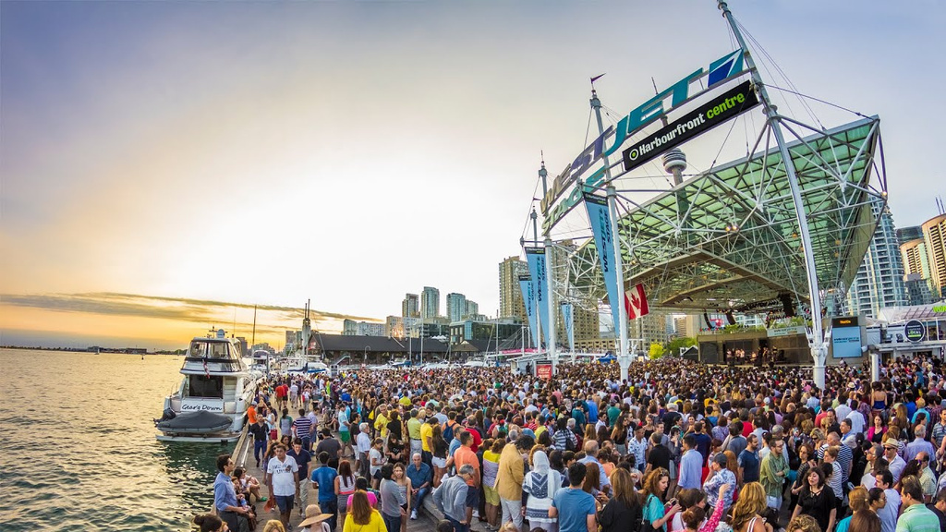

Recommendation 3:
Segment-Specific Campaigns
Launch live, trend-driven campaigns curated to the target segment’s interests, trends, and behavior, while promoting Flair FWD.
Sample campaign:
Ticket to
Pop-up events and booths to increase brand engagement, attract potential and returning customers, and position Flair FWD as innovative, fun, and community-oriented.
Targeted and high traffic locations:
Latin Festivals
in Toronto
Downtown area
Specifically Jamaican diaspora in Toronto.
Gen-Z.
Sample activities:
Each event would feature interactive challenges where participants can win prizes.
Spot the Flair
Carry on Challenge
Flair Pop Quiz:
19
Analysis
Recommendation
Implementation

Slide 20
Implementation
20

Slide 21
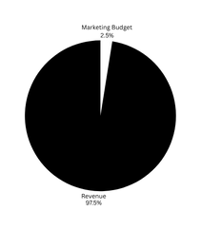
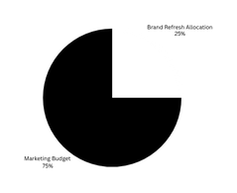
Assumptions
Implementation
Financial Impact
Estimated Annual Revenue:
$600M CAD
(based on media reported range of $500M–$800M)
Incremental Revenue
ULCC Marketing Spend:
2-3%
of revenue
Flair Marketing Spend:
2.5%
of revenue
$12.25M
3.64 ROI
Annual Marketing Budget :
$600M x 2.5%
$15M CAD
Cost
Brand Refresh Allocation
25%
of marketing budget
$3.36M
Campaign Budget
$3.75M
21
Analysis
Recommendation
Implementation

Slide 22
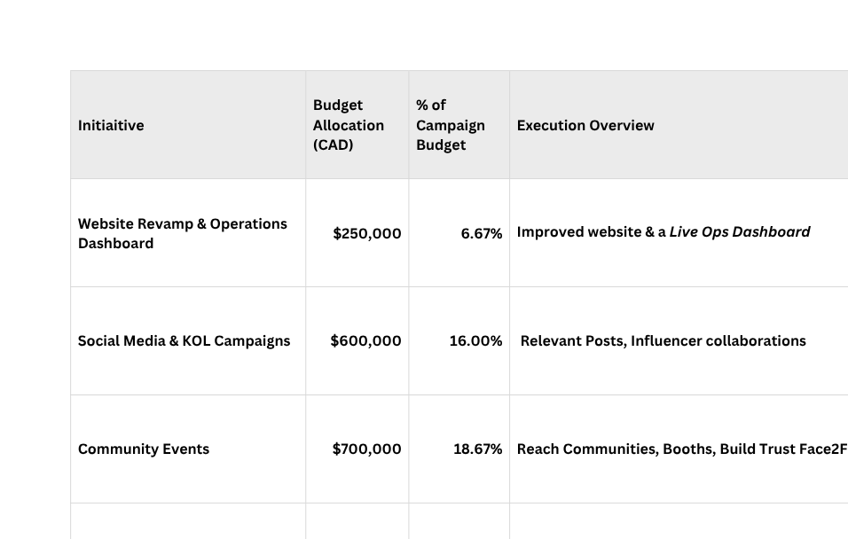
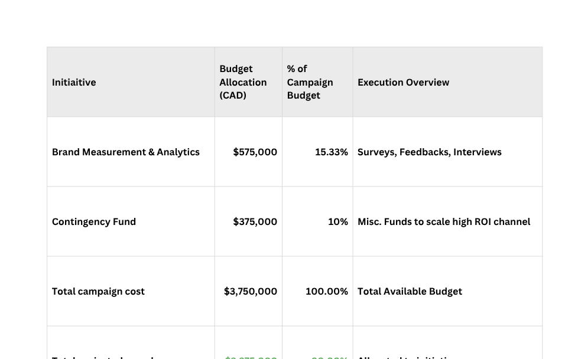
Implementation
Detailed Campaign Budget Allocation
Detailed Campaign Budget Allocation
Analysis
Recommendation
Implementation

Slide 23

Implementation
KPI Forecasts
Goals by 2026
Conversion Rate
Website Traffic
Brand Awareness Survey by Demographic
From negative to positive
15%
25%
Net Promoter Score (NPS)
for who has flown
Social Media Activities
First Time Flyers
0%
15%
98.2k
145k
Net Promoter Score (NPS)
for who has never flown
21.2k
45k
Brand Awareness by Channels
On Par with Porter Airlines
-13%
34%
Likes, comments
Analysis
Recommendation
Implementation

Slide 24
Implementation
KPI Forecasts
Goals by 2026
Brand Awareness by Channels
On Par with Porter Airlines
24
Analysis
Recommendation
Implementation

Slide 25
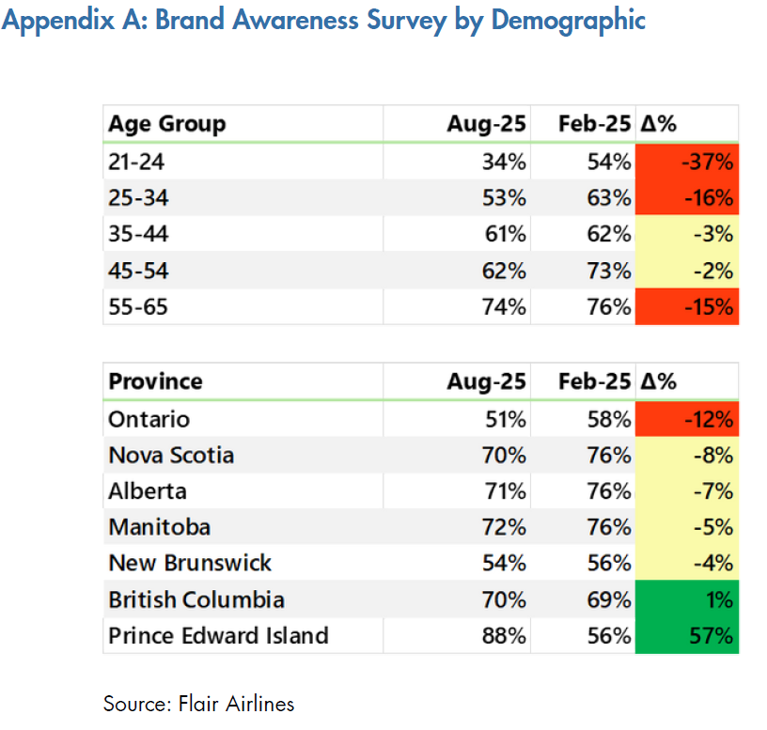
Implementation
KPI Forecasts
Goals by 2026
Brand Awareness by Channels
On Par with Porter Airlines
Brand Awareness Survey by Demographic
From negative to positive
25
Analysis
Recommendation
Implementation

Slide 26
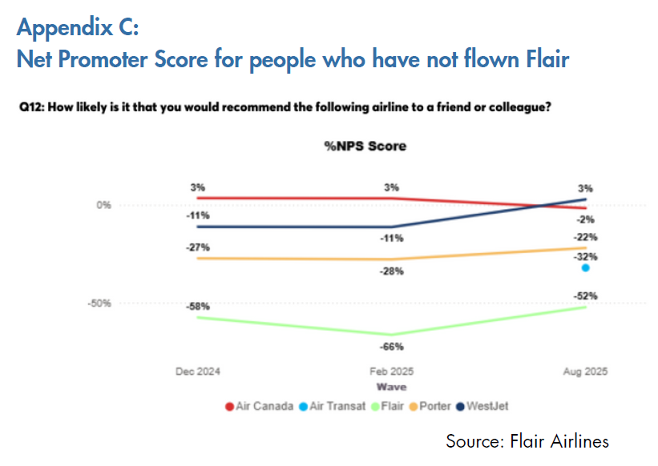
Implementation
KPI Forecasts
Net Promoter Score (NPS)
for who has never flown
-52%
0%
26
Analysis
Recommendation
Implementation

Slide 27
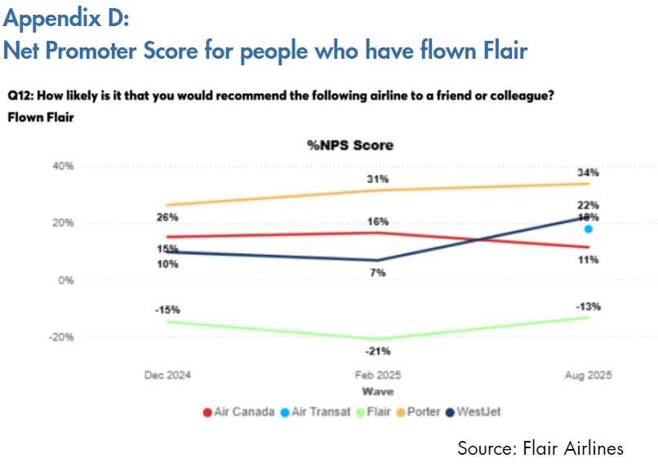
Implementation
KPI Forecasts
Net Promoter Score (NPS)
for who has never flown
-52%
0%
Net Promoter Score (NPS)
for who has flown
-13%
34%
27
Analysis
Recommendation
Implementation

Slide 28
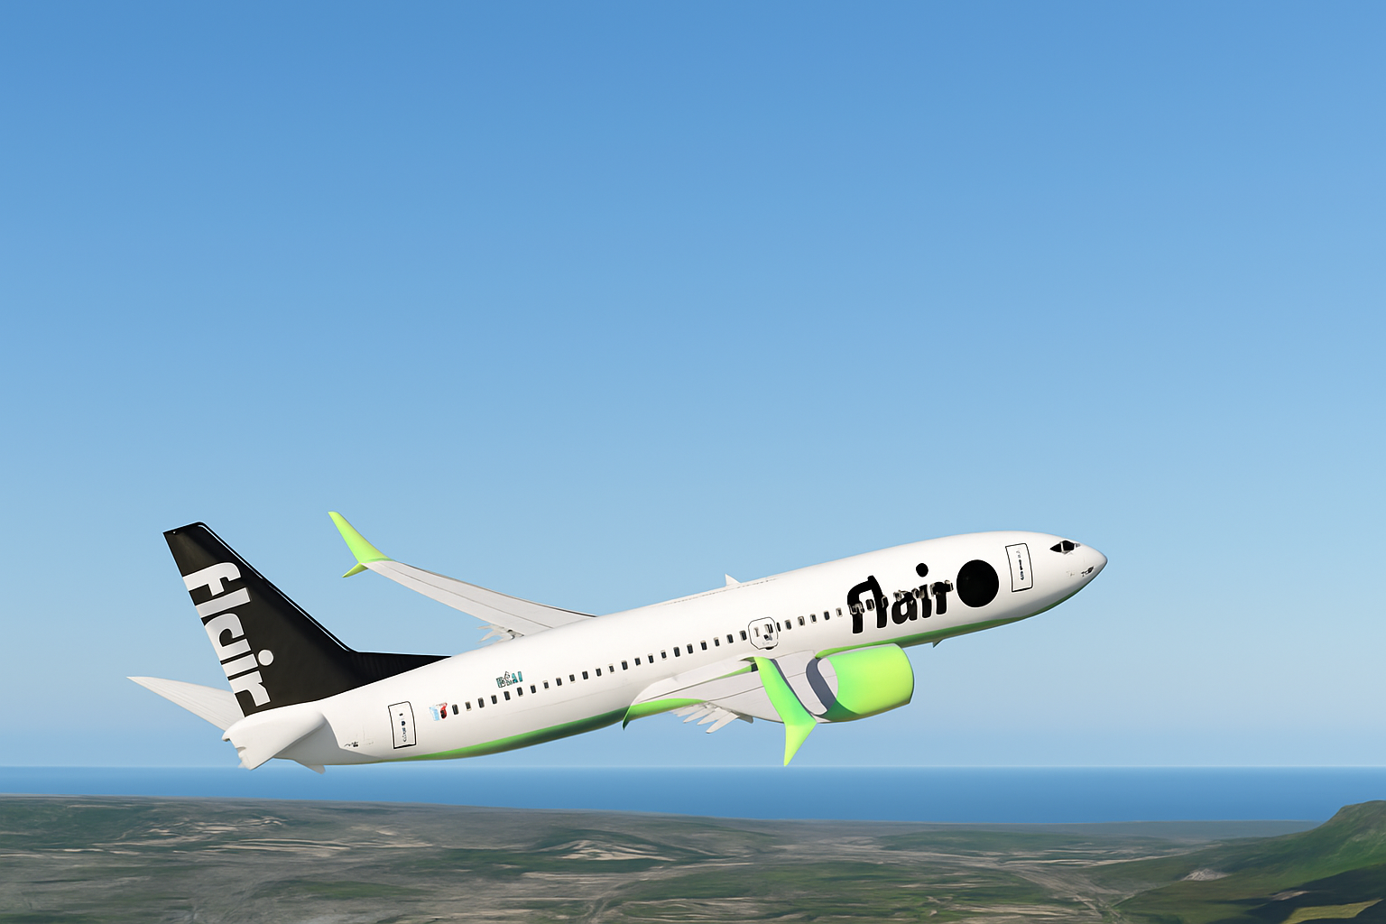
Together, we fly

Slide 29
Appendix
Work Cited
https://resources.disqo.com/industry-level-differences-in-brand-lift-and-outcomes-lift
https://competition bureau.canada.ca/sites/default/files/documents/market-study-airline-industry-2025-06-19-e.pdf?
https://www.wsj.com/world/americas/canadas-antitrust-watchdog-calls-for-easing-of-foreign-ownership-limits-in-airline-sector-305a1767?
https://www.amraandelma.com/top-cost-per-acquisition-statistics/?utm_source=chatgpt.com https://www.promodo.com/blog/tourism-marketing-benchmarks https://www.flyflair.com/flair-fwd
https://competition-bureau.canada.ca/sites/default/files/documents/market-study-airline-industry-2025-06-19-e.pdf?
https://www.promodo.com/blog/tourism-marketing-benchmarks
https://www.flyflair.com/flair-fwd
https://www.skyscanner.ca/tips-and-inspiration/gen-z-travel-statistics
Why You Need to Avoid Flair Airlines at All Costs
https://www.mckinsey.com/industries/travel/our-insights/the-way-we-travel-now
https://www.cnbc.com/2023/04/17/gen-z-travel-trends-travel-often-save-money-and-seek-adventure-.html
Flair is Canada's worst airline when it comes to passenger complaints
https://www.mckinsey.com/industries/travel/our-insights/the-evolving-role-of-experiences-in-travel

Slide 30
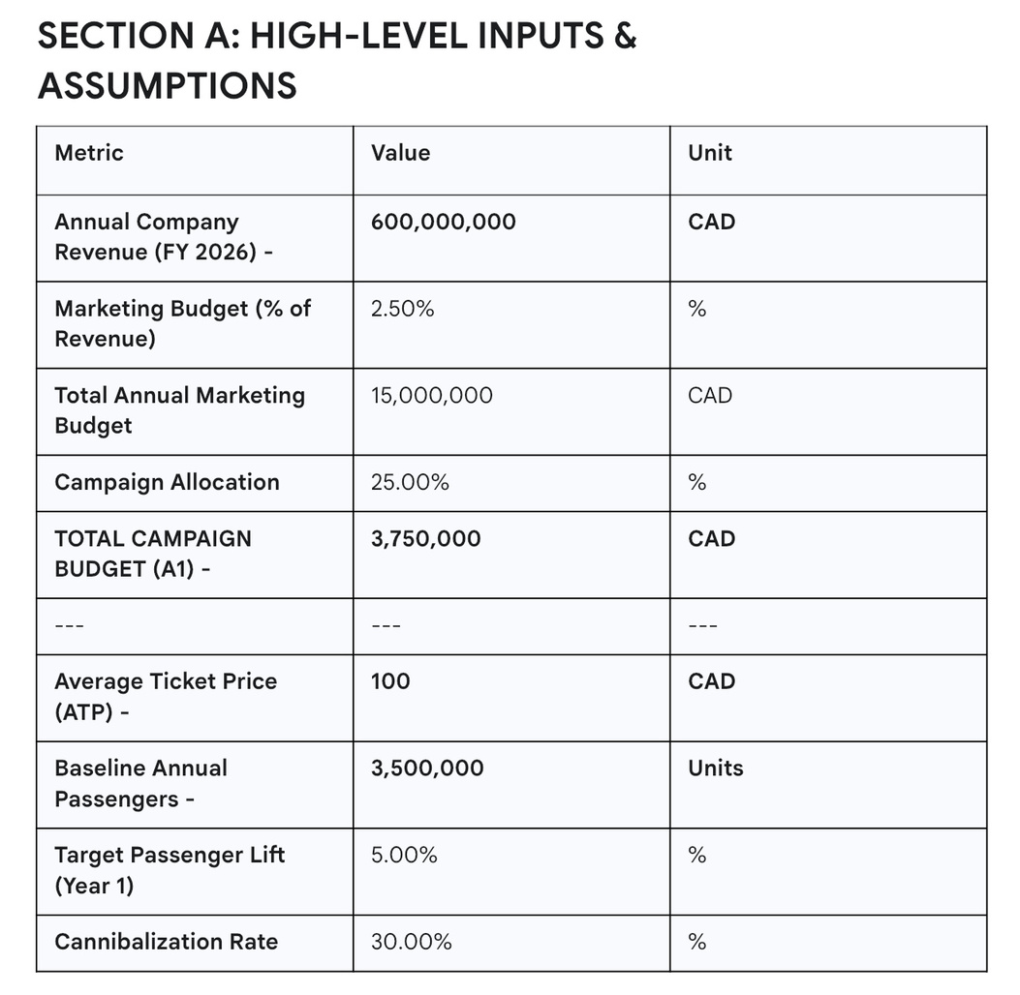
Appendix
High Level Inputs & Assumptions

Slide 31
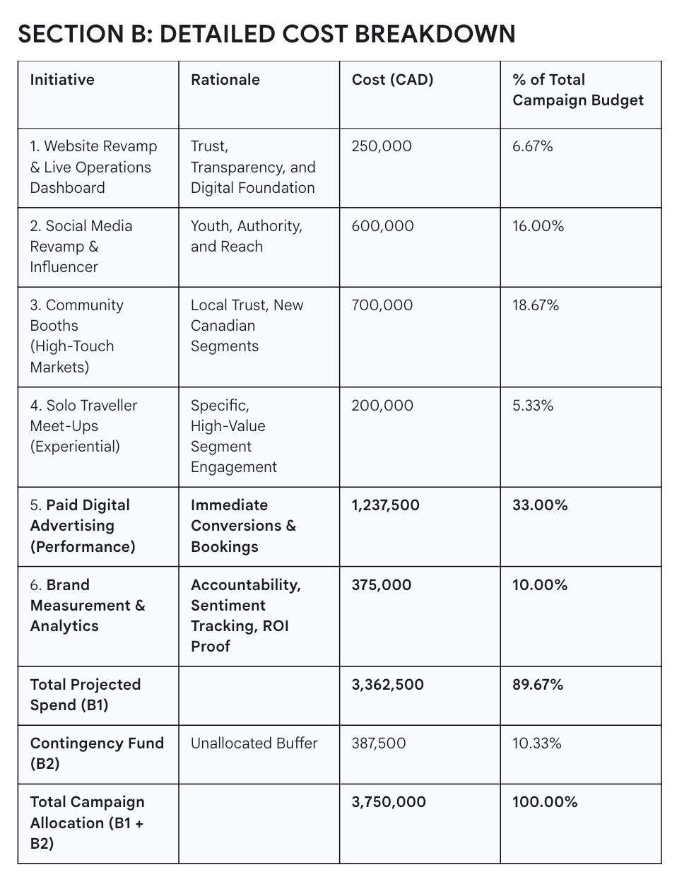
Appendix
Detailed Cost Breakdown

Slide 32
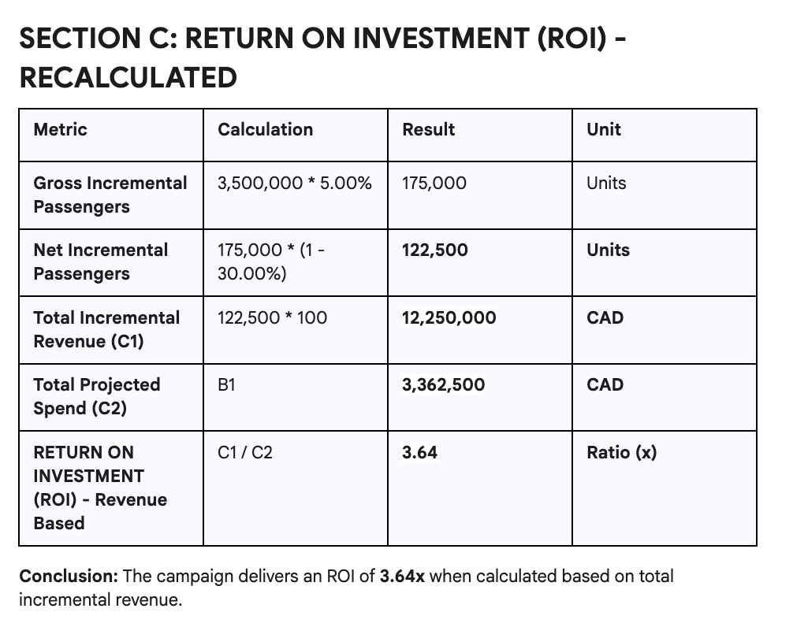
Appendix
Return on Investment (ROI) - Recalculated

Slide 33
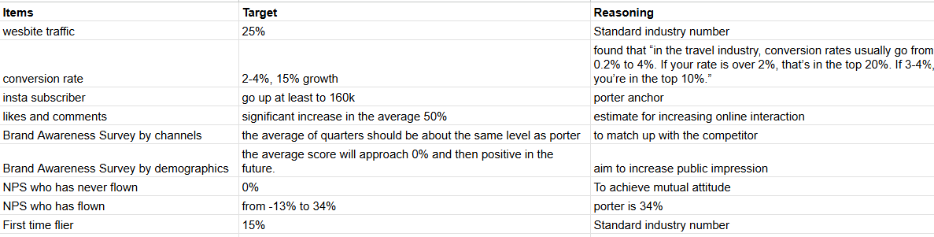
Appendix
KPI Rationale

Slide 34

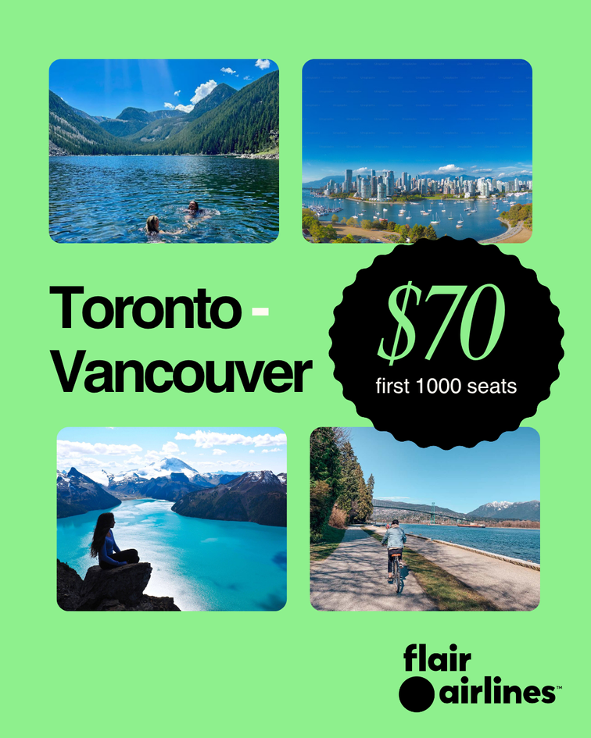

Appendix
Sample Social Media Content

Slide 35
Appendix
Sample Social Media Content

